Slide 1
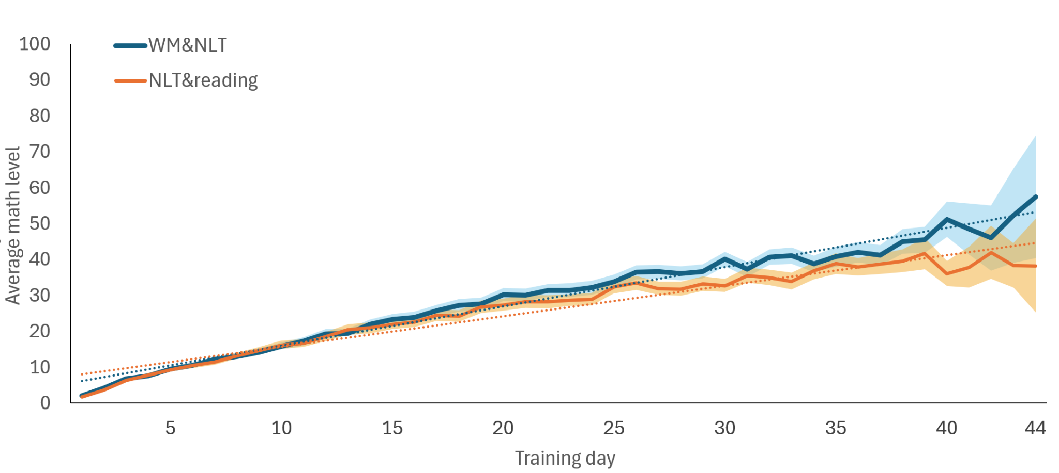
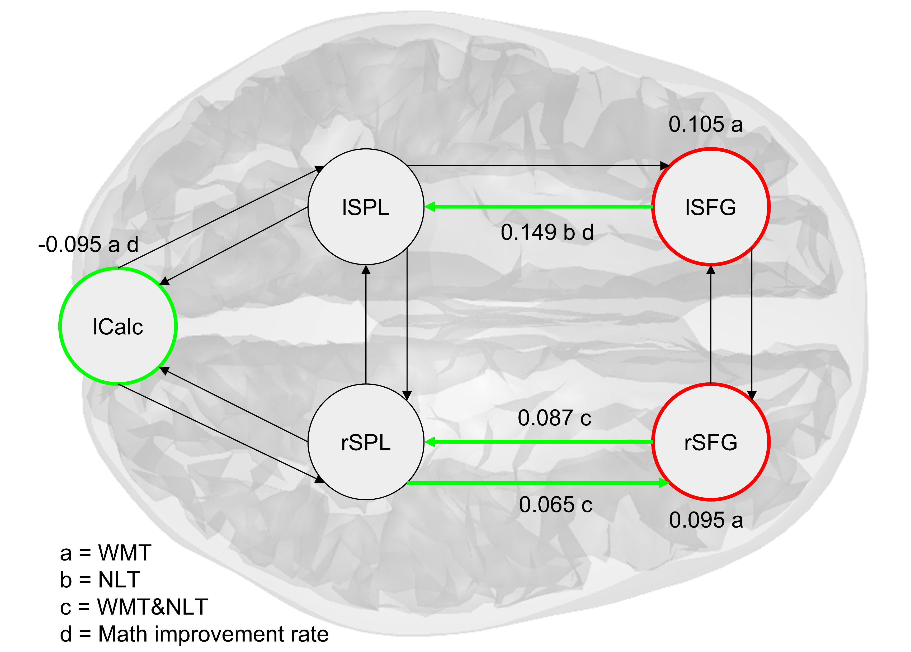

Effective Connectivity Reveals Training-Specific Neural Plasticity and Predicts Learning Gains in Children: A Dynamic Causal Modeling Study
Children trained on Working Memory and Math tasks have different learning trajectories than children with Math and Reading only.
BOLD amplitude does not fully capture training-induced plasticity.
Dynamic Causal Modelling (DCM), measuring (directional) Effective Connectivity reveals training-induced plasticity changes that can also differentiate between the training conditions.
54 primary school children underwent longitudinal fMRI scans, performing a Working Memory task in the scanner before and after digital cognitive training.
This highlights DCM as a tool for evaluating the effectiveness of interventions by measuring specific connectivity parameters, enabling us to improve shared underlying cognitive machinery.
Andreas Lidströmª, Torkel Klingbergª 2025
ªKarolinska Institute, Department of Neuroscience, C4 Neurovetenskap, C4 Forskning Klingberg, 171 77 Stockholm, Sweden

